Slide 1
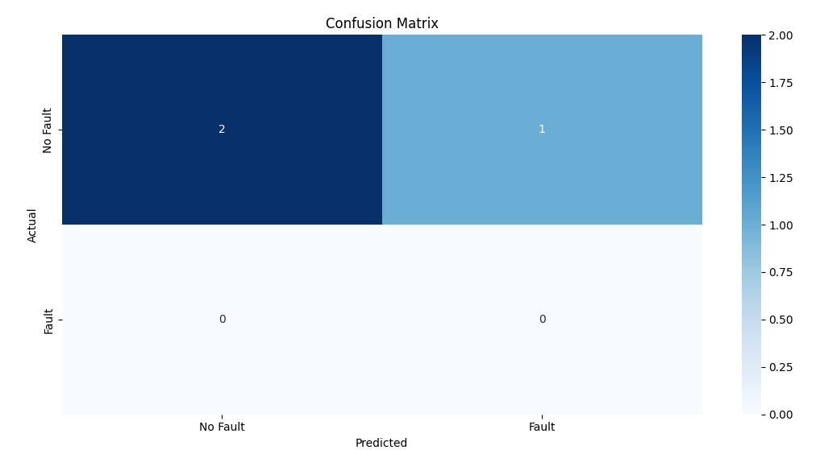
🔍 ML-Aided Scan Chain Fault Prediction using Verilog Testbench
What are you trying to do? Predict scan chain output response under injected faults
a trained ML model.
How have others done it?
Traditional fault simulation and manual analysis in Verilog
ATPG tools to generate vectors for fault coverage
No ML integration in basic scan test environments
What are you doing differently?
Integrating Verilog testbench output with a Python ML pipeline
Training a Decision Tree Classifier using scan pattern bits &
fault info
Visualizing feature importances to understand model behavior
What have you accomplished so far?
Simulated 8-bit scan chain in Verilog with a stuck-at-0 fault at
bit 3
Collected scan_out data for 16 patterns
Trained ML model achieved ~100% accuracy
Identified key features contributing to fault prediction
🛠 Verilog Scan Chain → 📊 DataFrame → 🤖 ML Classifier → ✅ Accuracy & Insights

